Slide 1
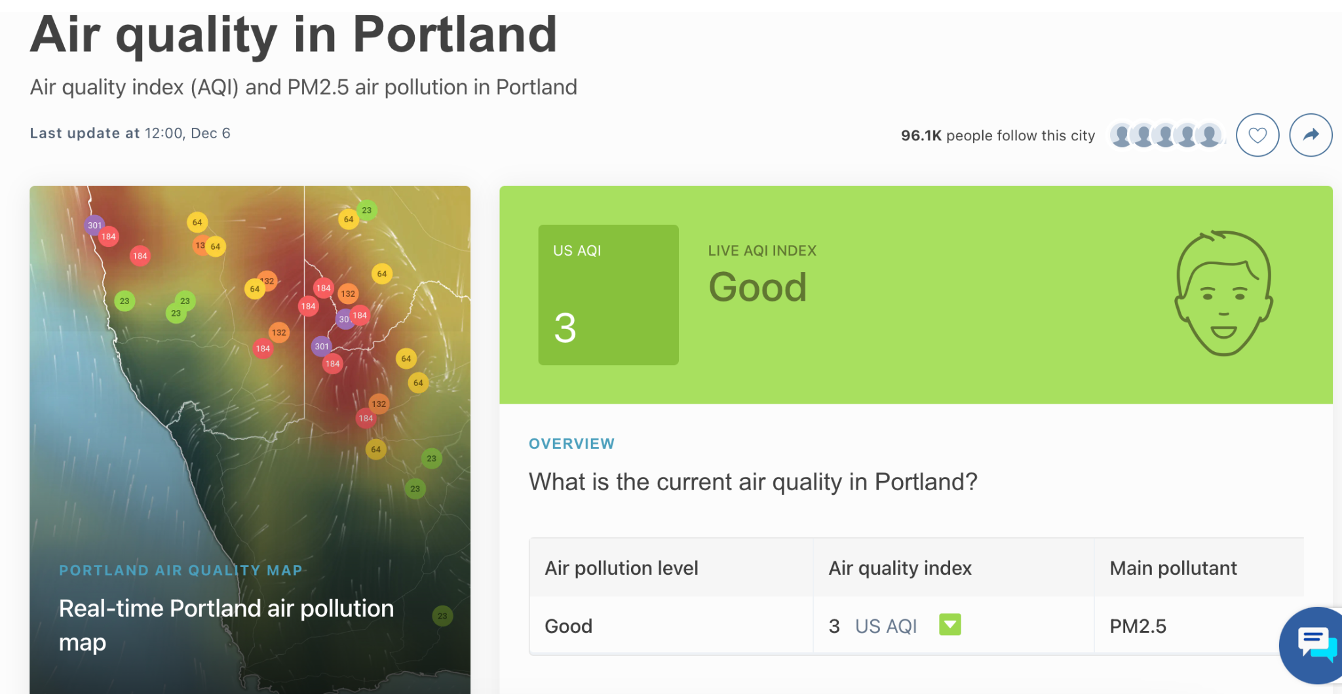
Air Quality
What do you know about air quality?
What is being measured to give us air quality data?
What does it mean to have “good” air quality?
Notes:
Teacher notes:
Ask students to talk in groups/partners about these questions.
Ask students to share out with the class.
Record ideas on the board to collect what we already know.

Slide 2
Factors of AQI
Group research on one factor of AQI
Collect research on group slide
Gallery walk and notes to learn about other factors

Slide 3
Air Quality: Group Research on Factors
Ground Level Ozone | Group ?
Particulate Matter PM_{2.5} | Group ?
Particulate Matter PM₁₀ | Group ?
Carbon Monoxide | Group ?
Nitrogen Dioxide | Group ?
Sulfur Dioxide | Group ?
Notes:
Teacher notes:
Assign groups or have students choose. Might need to double up if you have more than 6 groups.
Use template slides below for students to conduct and collect research. Either give students edit access to whole slideshow or assign a slide to the students doing the research on that factor.

Slide 4
Ground Level Ozone Group Member Names
Basics from EPA
American Lung Association
Dept of Ecology (Washington state)
What is it?
How does it affect the environment?
What causes it?
How does it affect people?

Slide 5
^{PM}2.5
Group Member Names
Basics from EPA
American Lung Association
Dept of Ecology (Washington state)
What is it?
How does it affect the environment?
What causes it?
How does it affect people?

Slide 6
^{PM}10
Group Member Names
Basics from EPA
American Lung Association
Dept of Ecology (Washington state)
What is it?
How does it affect the environment?
What causes it?
How does it affect people?

Slide 7
Carbon Monoxide
Group Member Names
Basics from EPA
American Lung Association
Dept of Ecology (Washington state)
What is it?
How does it affect the environment?
What causes it?
How does it affect people?

Slide 8
Nitrogen Dioxide
Group Member Names
Basics from EPA
American Lung Association
Dept of Ecology (Washington state)
What is it?
How does it affect the environment?
What causes it?
How does it affect people?

Slide 9
Sulfur Dioxide
Group Member Names
Basics from EPA
American Lung Association
Dept of Ecology (Washington state)
What is it?
How does it affect the environment?
What causes it?
How does it affect people?

Slide 10
Collect Information from Other Groups!
Discuss the big ideas from your slide
Make sure you are ready to share with other groups
Choose 1-2 people to stay and explain the ideas to the other groups
The rest of your group will travel around to other groups
Notes:
Teacher notes:
Merge groups that researched the same topic
In your group, discuss the main ideas from the slide and decide who will stay and share the big ideas
The rest of the group will travel to other stations and return with info

Slide 11
Collect Information from Other Groups!
Use the visual on the board to rotate from one group to the next
I’ll set a timer for each rotation
TALK TO EACH OTHER!
Traveling members, visit the other groups, learn about their AQI factor, and record the information on the document posted in Google Classroom
When you return back to your group, share what you learned with the members who stayed behind
Notes:
Teacher notes:
Draw a visual for the route groups will take around the room and set a timer for each station.
Encourage students to talk to each other rather than just reading the slide.
Traveling members will record ideas on google doc or paper copy.
When traveling members return to their original stations, have them share what they learned about each factor with the students who stayed to teach.

Slide 12
Next Steps
Next time, we will talk more about air quality in the Portland Area and how it has potentially changed in your lifetime.
We will learn more about Data Science and how data scientists use large public data sets to answer questions!

